Slide 1
Light
Unit 3 Module 2

Slide 2
How Light Travels
MS-PS4-2. Develop and use a model to describe that waves are reflected, absorbed, or transmitted through various materials.
WALT:
I can develop and use models to describe light’s path as straight line and to describe how objects function to interact with light waves through reflection, absorption and transmission.
WILF:
I will be able to categorize the characteristics of different types of electromagnetic waves.
I will be able to identify the uses of electromagnetic waves.
I will be able to model the path light travels.
I will be able to collect evidence that light can be reflected, absorbed, or transmitted when it shines on an object.

Slide 3
What is light?
Suppose you are touring an underground cave and the lights go out. Would you be able to see anything?
No! There would be no light for your eyes to sense.
Light is electromagnetic radiation that you can see.
Electromagnetic radiation is a type of wave created by vibrating particles.

Slide 4
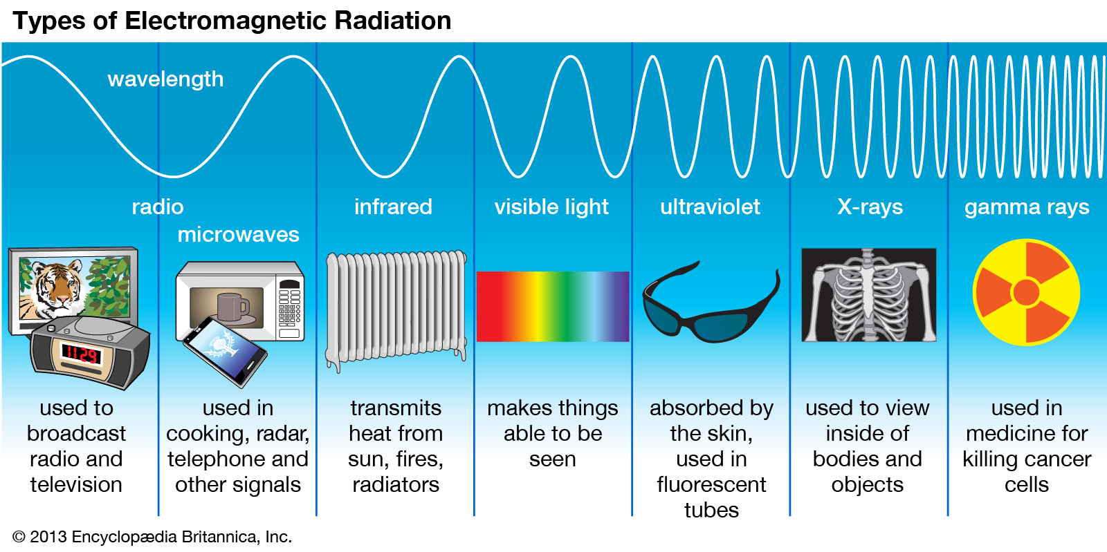
As shown in the figure below, there are different types of electromagnetic waves.
The frequency of a light wave depends on the amount of energy.
Light waves can carry this energy through space and some matter.
Energy carried by an electromagnetic wave is called radiant energy.

Slide 5
Properties of Light
The wavelengths of light waves are very short.
Because they are so short, they are usually measured in nanometers (nm).
One nanometer equals one-billionth of a meter.
The wavelengths of light waves range from about 700 nm to about 400 nm.
This is about one-hundredth the width of a human hair.
When different wavelengths of light waves enter your eyes, you see them as different colors.

Slide 6
Energy
As the frequency of an electromagnetic wave increases, the energy of the wave also increases.

Slide 7
Brightness
The brightness of a light is a person’s perception of intensity.
Your eyes might be more sensitive to light than your friend’s eyes.
The intensity of light is the amount of energy that passes through a square meter of space in one second.
It depends on the amount of energy emitted by the source.
Light from a flashlight has a much lower intensity than light from the Sun.
Intensity also depends on the light’s distance from the source.
The environment also can affect brightness

Slide 8
How does light reach Earth?
The Sun emits energy by giving off electromagnetic waves. Only a tiny amount of these waves reach Earth.

Slide 9
Speed of Light
Electromagnetic waves can travel through a vacuum where no matter is present.
For example, light can travel through the space between Earth and the Sun.
Light waves travel fastest through a vacuum. The speed of light waves in a vacuum is about 300,000 km/s.
Light waves travel about 900,000 times faster than sound waves.
When light enters matter, it slows.
This is because of interactions between the waves and the particles that make up matter.
Light waves travel at different speeds in different materials.

Slide 10
How does light move from a source to your eye?
Light travels as waves moving away from a source.
Light makes it possible for you to see objects.
It can travel directly from a source. It can also be seen reflecting off some objects.
Light waves can be described as countless rays spreading out in all directions from a source.
Shadows form when an object blocks the path of these rays.
Shadows show that light normally travels in a straight line.
Light can spread out slightly as it moves through a small opening.

Slide 11
How does light interact with matter?
Matter can transmit, absorb, or reflect waves.
How do these interactions affect light that travels from a source to your eyes?

Slide 12
Transmission, scattering and absorption
Air and clear glass transmit light with little or no distortion.
A material that allows almost all of the light striking it to pass through, and through which objects can be seen clearly is transparent.
Materials such as waxed paper or frosted glass also transmit light, but you cannot see objects through the materials clearly.
Light that moves through the material is scattered.
A material that allows most of the light that strikes it to pass through, but through which objects appear blurry is translucent.
Some materials absorb most of the light that strikes them. These materials transmit no light.
Therefore, you cannot see objects through them.
A material through which light does not pass is opaque.

Slide 13
Reflection
Why can you see your reflection clearly in a mirror but not in the wall of your room?
Waves reflect off surfaces according to the law of reflection.
Light rays that reflects from a smooth surface form a clear image.
Rays that reflects from a bumpy surface scatter in many directions.
A wall seems smooth, but up close it is too bumpy to form a clear image.
Different types of matter interact with light in different ways.
For example, a window transmits and reflects light.
Although you can see through a transparent window, you also can see your reflection.
Some of the light that strikes an opaque object, such as a book, is absorbed and reflected at the same time.

Slide 14
Law of Reflection
Light reflects a lot like a tennis ball bouncing off a wall.
Straight arrows called rays show how light reflects, as seen in the figure to the left.
An imaginary line perpendicular to a reflecting surface is the normal.
The light ray moving toward the surface is the incident ray.
The light ray moving away is the reflected ray.
Notice the angle formed where an incident ray meets a normal. This is the angle of incidence.
A reflected ray forms an identical angle on the other side of the normal.
This angle is the angle of reflection.
According to the law of reflection, when a wave is reflected from a surface, the angle of reflection is equal to the angle of incidence.

Slide 15
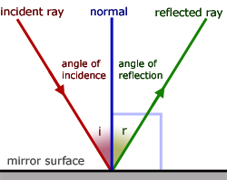
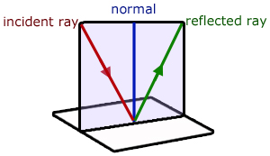

Slide 16
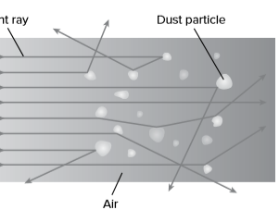
Scattering
Dust particles have different shapes.
As a result, the particles reflect the light waves in many different directions.
This is an example of scattering.
Scattering occurs when waves traveling in one direction are made to travel in many different directions.
The dust particles scatter the light waves in the sunbeam.

Slide 17
Refraction and Lenses
Light always travels through empty space at the same speed— about 300,000 km/s.
Medium Interactions
Light travels more slowly when it moves through a medium such as air, glass, or water.
This is because the atoms of the material interact with the light waves and slow them down.
Refraction of Light
As a light wave moves from one medium into another, its speed changes.
If the wave enters the new medium at an angle, the wave will change direction.
The change in direction of a wave as it changes speed while moving from one medium to another is called refraction

Slide 18
Lenses
A lens is a transparent object with at least one curved side that causes light to change direction.
Most of the light that strikes a transparent material passes through it. Light refracts as it passes through a lens.
The greater the curve of the lens, the more the light refracts.
The direction of refraction depends on whether the lens is curved outward or inward.
A lens that is thicker in the middle than at the edges is a convex lens.
A lens that is thicker at the edges than in the middle is a concave lens.

Slide 19
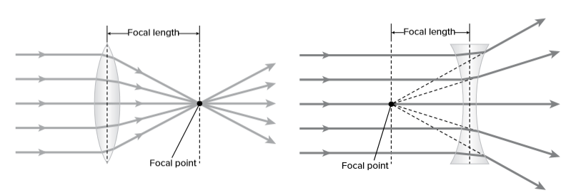
Convex and Concave Lenses
Light rays that move through a convex lens come together or converge. Convex lenses are called a converging lenses.
as light rays move through a concave lens, they spread apart, or diverge. Concave lenses are often called diverging lenses.

Slide 20
Light and Color
When light waves of different wavelengths strike an object, the object absorbs some light waves and reflects others.
The materials that make up the object determine the wavelengths of light that the object absorbs or reflects.
A red rose reflects light waves with certain wavelengths and absorbs all other wavelengths of light.
When the reflected light waves enter your eye, they cause cone cells in your retina to send certain nerve signals to your brain.
These signals cause you to see the rose as red.
A banana absorbs and reflects different wavelengths of light than a red rose does.
The reflected wavelengths cause cone cells to send different signals to your brain.
These signals cause you to see the banana as yellow. Light waves have no color.

Slide 21
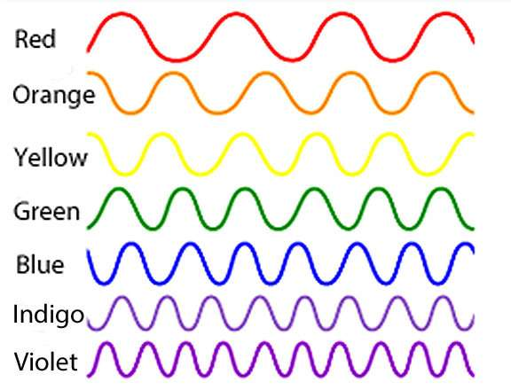
Color is a sensation produced by your brain when light waves enter your eyes.
The colors you see may include red, orange, yellow, green, blue, indigo, and violet.
These colors have different wavelengths.

Slide 22
How do different colors of light affect what we see?
Waves with longer wavelengths travel at greater speeds in a material than waves with shorter wavelengths.
Therefore, when entering a material, light with longer wavelengths travels faster and refracts less than light with shorter wavelengths.
As a result, violet refracts the most because its wavelength is the smallest. Red has the longest wavelength and refracts the least.

Slide 23
Color of Objects
Some objects, such as the Sun, lightbulbs, and neon lights, emit light.
The color of an object that emits light depends on the wavelengths of the light waves it emits.
For example, a red neon light emits light waves with wavelengths that you see as red.

Slide 24
Colors of Light
Suppose white light shines through blue glass.
The glass absorbs all wavelengths of light except blue.
The blue wavelengths pass through the glass to your eyes.
If the blue glass is translucent, it transmits blue light, but the image is blurry.
Transparent or translucent objects are the colors they transmit.

Slide 25
Colors Filters
Suppose you are wearing a shirt and you are in white light.
The shirt appears blue under the white light.
The only wavelengths that you see are blue.
If a color filter is applied to the light and only blue light is shown on the shirt, the blue light is reflected.
The shirt still appears to be blue.
If another color filter is used, such as red, the red light is absorbed and no light is reflected.
The shirt appears black under the red light.
The color you see always depends on the color of light the object reflects.

