Slide 1
Introduction to Waves
Mechanical Wave Interactions
MS-PS4-2

Slide 2
How do waves interact with matter?
Waves interact with matter in many ways.
Waves can be reflected by matter.
Waves can change direction when they travel from one material to another.
Also, as waves move through matter, some of the energy they carry can be transferred to the matter.

Slide 3
Interaction of Waves With Matter
When waves reach the surface of a material, they can be reflected.
Reflection is the bouncing of a wave off a surface.
All waves reflect when they hit a surface.
An echo is an example of a sound wave reflecting.
Ocean waves reflect off boats, islands, and piers.
Reflection causes waves to change direction.
When you drop a basketball at an angle, it bounces up at the same angle but in the opposite direction.
When waves reflect from a surface, they change direction like a basketball bouncing off a surface.

Slide 4
Absorption
When you shout, you create sound waves.
As the waves travel in air, some of their energy transfers to particles in the air.
As waves travel through matter, the energy they carry decreases.
Absorption is the transfer of energy by a wave to the medium through which it travels.
The amount of energy absorbed depends on the type of wave and the material in which it moves.
In the figure below, the sound from the cell phone is absorbed by the insulation in the wall.

Slide 5
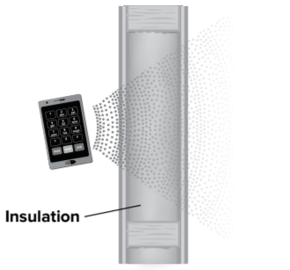
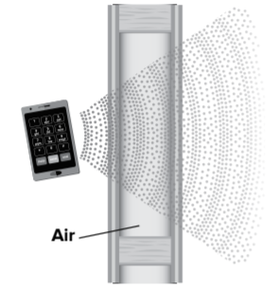

Slide 6
Transmission
Sometimes when a wave interacts with matter, the matter does not absorb all the energy.
The matter can transmit some of the energy to the other side of the barrier and it will continue as a wave.
Transmission is the passage of a wave through a medium.
The sound from a cell phone in the figure above transmits easily through an uninsulated wall.
Mechanical waves can also travel through liquids and gases.
Without transmission we would not hear sound waves on the other side of doors.

Slide 7
Engineering Connection
Acoustical engineers must take interactions of sound waves into account when they are designing a concert hall.
Engineers carefully choose the shapes and materials to control sound waves.
The stage has a wooden floor to improve vibrations.
The curved panels on the ceiling reflect sound waves in different directions to fill the space.
Highway sound barriers are another example of controlling sound waves.
The barriers are often made from wood, concrete, or metal.
The barriers keep highway noise away from neighborhoods.
Higher walls reflect more sound from the hard surface.

Slide 8
Life Science Connection
Waves interact with matter when we hear sound.
Sound waves enter the ears with information about the environment.
The human ear has three main parts, as shown in the figure below.
Sound waves interact with different medium and structures within the ear as the waves move.

Slide 9
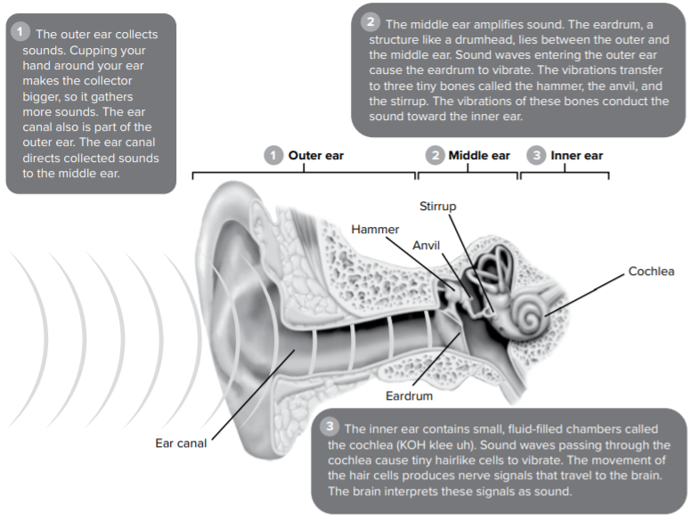

Slide 10
What affects how a wave travels through matter?
Consider how quickly an ocean wave comes to shore or how a car horn can be heard almost immediately.
Do all waves interact with matter in the same way?
Different factors such as density and temperature affect the movement of waves.
Let’s explore how sound waves interact with different materials.

Slide 11
Speed of Sound
Sound waves traveling through air cause most of the sounds you hear every day.
Recall that sound waves can also travel through liquids and solids.
Like all types of waves, the speed of a sound wave depends on the material in which it travels.
Sound waves travel at different speeds in different materials.
The denser the material is, the faster a sound wave can move through it.
Solids and liquids are usually denser than gases. Sound waves move fastest through solids and slowest through gases.

Slide 12
A sound wave’s speed also depends on the strength of the forces between the particles—atoms or molecules—in the material.
The stronger these forces, the faster a sound wave can move through the material.
These forces are usually strongest in solids and weakest in gases.
Overall, sound waves usually travel faster in solids than in liquids or gases.
The temperature of a material also affects the speed of a sound wave.
The speed of a sound wave in a material increases as the temperature of the material increases.
For example, the speed of a sound wave in dry air increases from 331 m/s to 343 m/s as the air temperature increases from 0°C to 20°C.
Therefore, sound waves in air travel faster on a warm, summer day than on a cold, winter day.

Slide 13
Diffraction
Waves can also change direction as they travel by objects.
Have you ever heard people talking in a room before you got to the open doorway?
You heard some of the sound waves because they changed direction and spread out as they traveled through the doorway.

Slide 14
Diffraction
Diffraction is the change in direction of a wave when it travels by the edge of an object or through an opening.
Diffraction causes waves to travel around the edges of an object.
Diffraction also causes waves to spread out after they travel through an opening.
More diffraction occurs as the size of the object or opening becomes similar in size to the wavelength of the wave.

